Slide 1

welcome to our workshop! foes: Teaching JavaScript fundamentals through open-source development
Alec burns, Sheondra baker, Alex shaklee

Slide 2
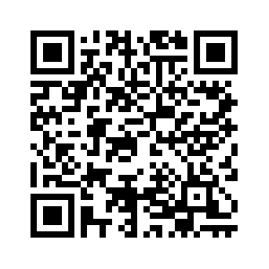
pre-survey
LINK
ABURNS10.ALTERVISTA.ORG OR
When asked which group this is, this is ‘Foes’

Slide 3
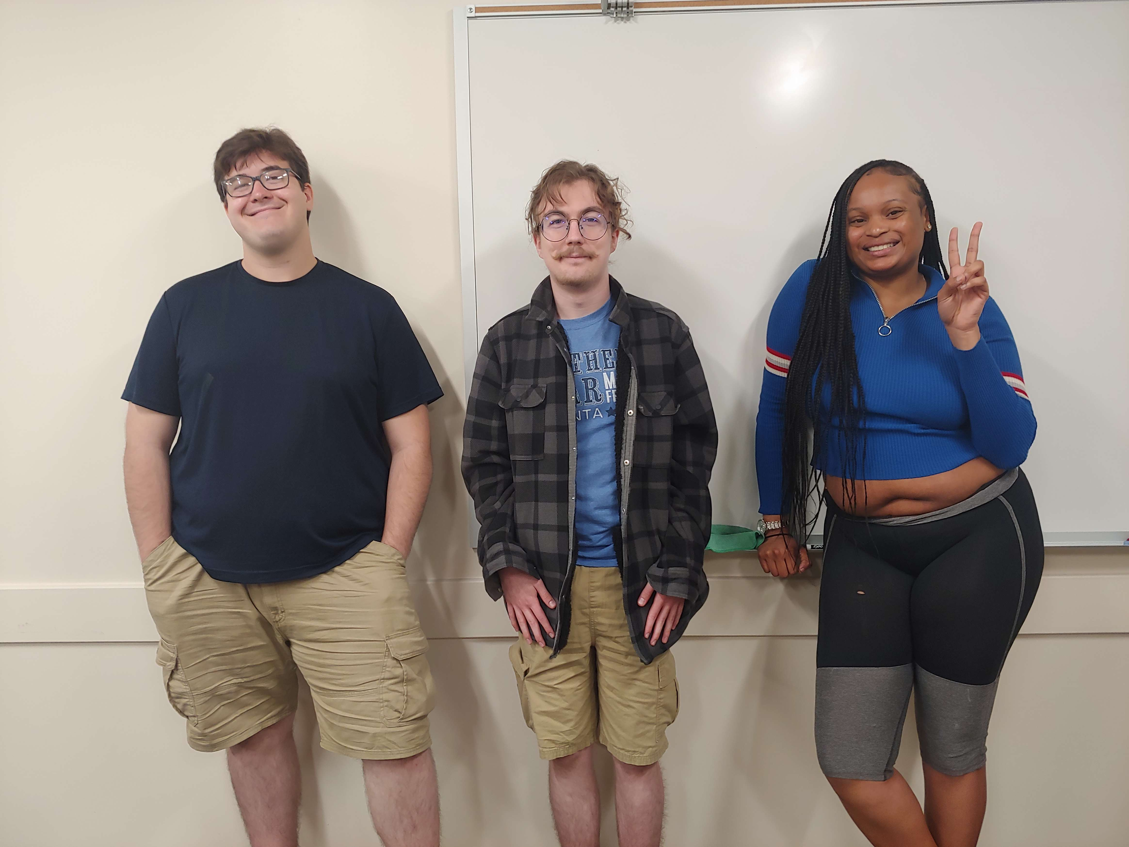
Introduction: Creators of “foes”
Alec Burns
Alex Shaklee
Sheondra Baker

Slide 4
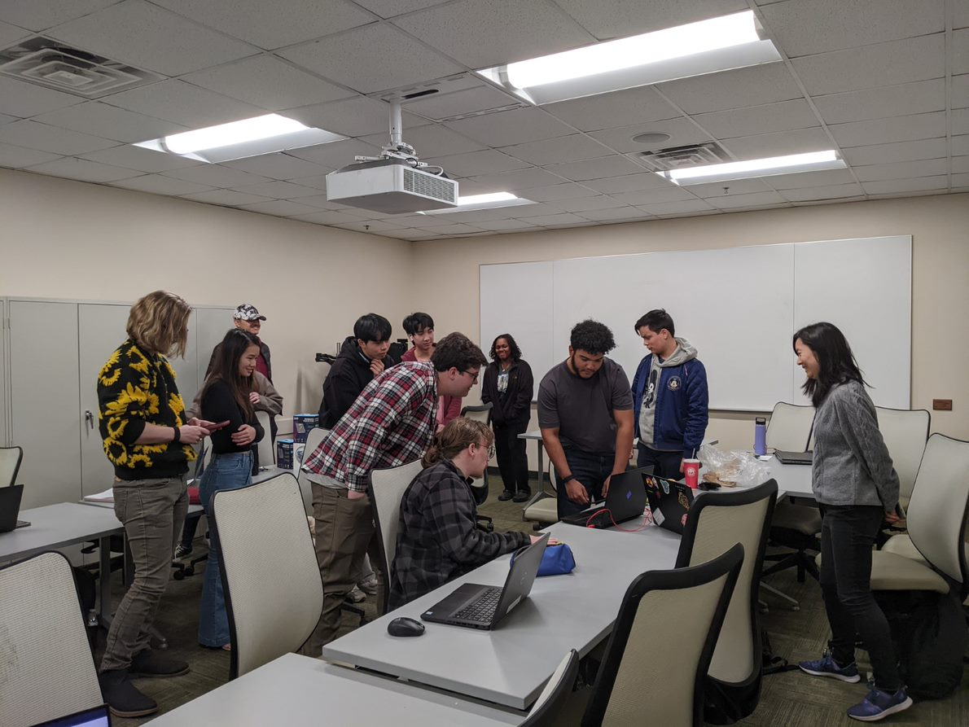
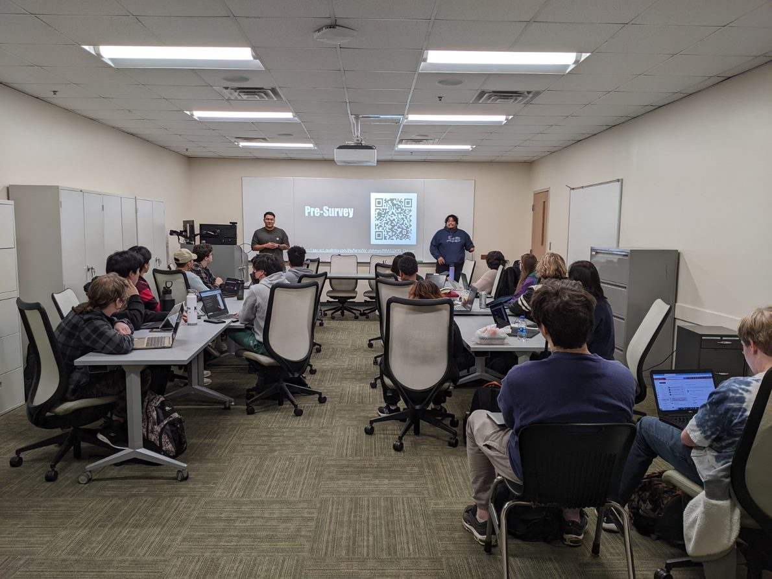
What is tap?
GGC's Technology Ambassador Program (TAP) is a program designed to give undergraduate students the opportunity to work on technical, leadership, and communication skills, all while creating projects designed for community outreach.
Expectations | Examples of Technology | Team Deliverables
Students must participate in groups of 3-4 to gain experience with a chosen technology. Students then must present and teach their chosen technology, both to invoke interest in their community and to achieve a deeper understanding for themselves. | Online Games (Scratch, JS) Games in Unity Hardware Controllers (Makey Makey, Arduino) AR / VR Technology and Programming 3D Printing Robotics / Drones (Sphero, Codrone) | Teams must construct a project using their chosen technology and perform Workshops, demonstrating their project and ideally sparking interest in the audience. Teams must also participate in service learning events (GGC's Super Saturday Series, Atlanta Science Festival, etc.).
STEC - 4800

Slide 5
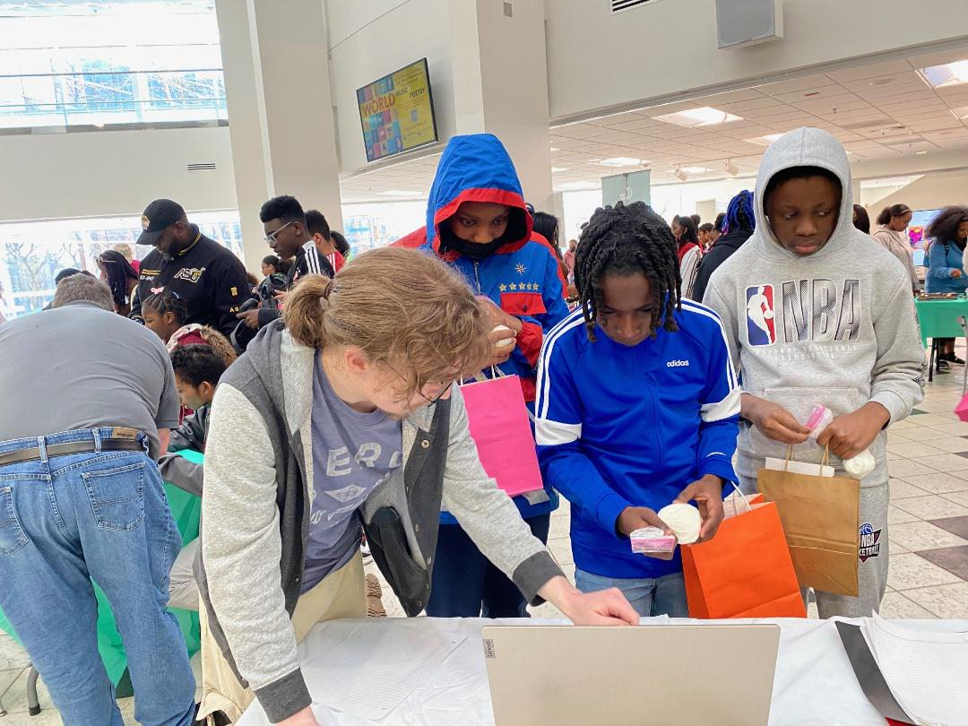
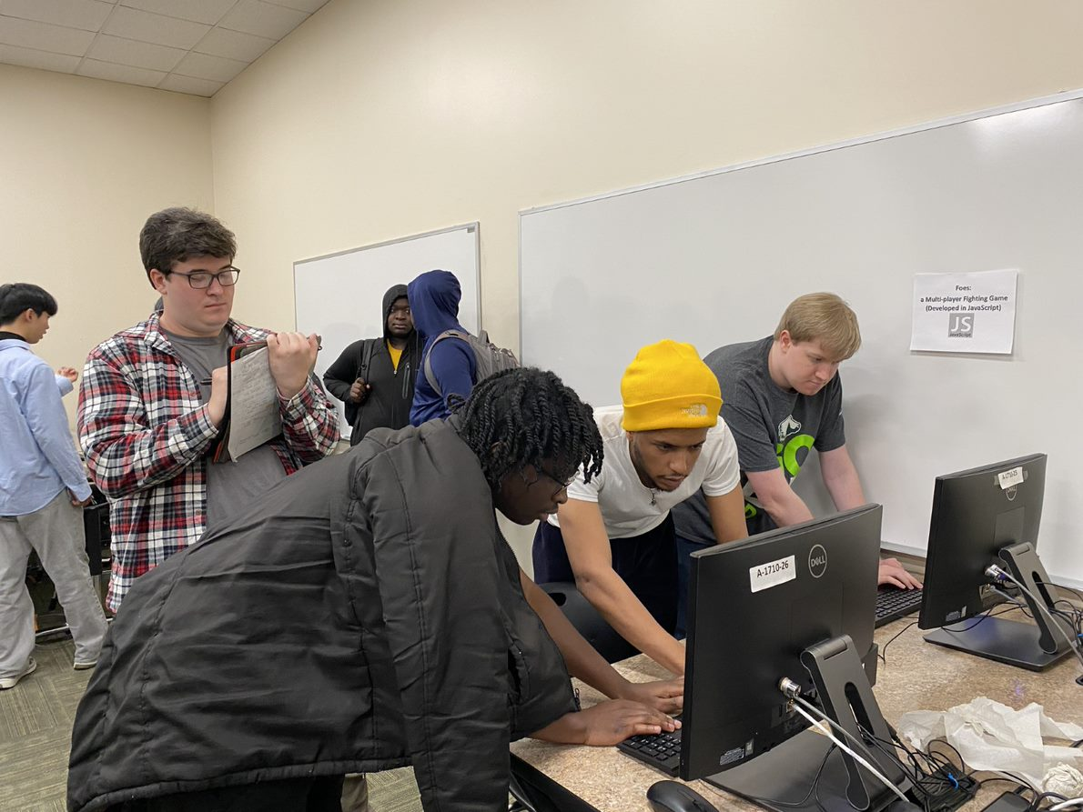
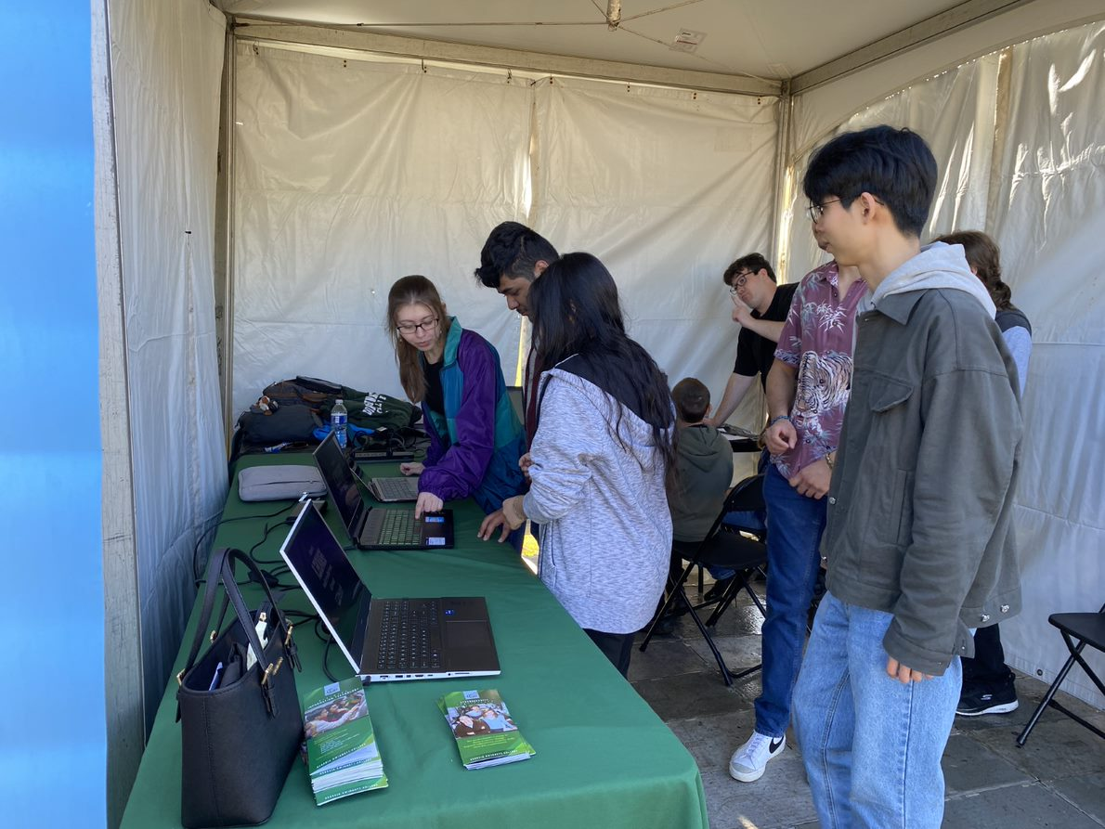
Event Examples:
ASF GGC
GGC's TAP Expo
ASF At Piedmont Park

Slide 6
Other Groups
Team 'FruitRain':
A game designed in Processing using Makey-Makey kits.
The game is focused around teaching basic programming fundamentals in the form of a quiz.
Touching a specific fruit registers as an input.
Team Sphero:
Designed a 'Dance' program using Sphero robots to the tune of the Backstreet Boys.
The program was designed in Scratch, and used to teach basic programming logic / fundamentals.
Team 'Alien Invaders':
Designed a 2 player game in Processing.
The game is similar to Galaga and Space Invaders, with the player that destroys all of their enemies first winning.

Slide 7
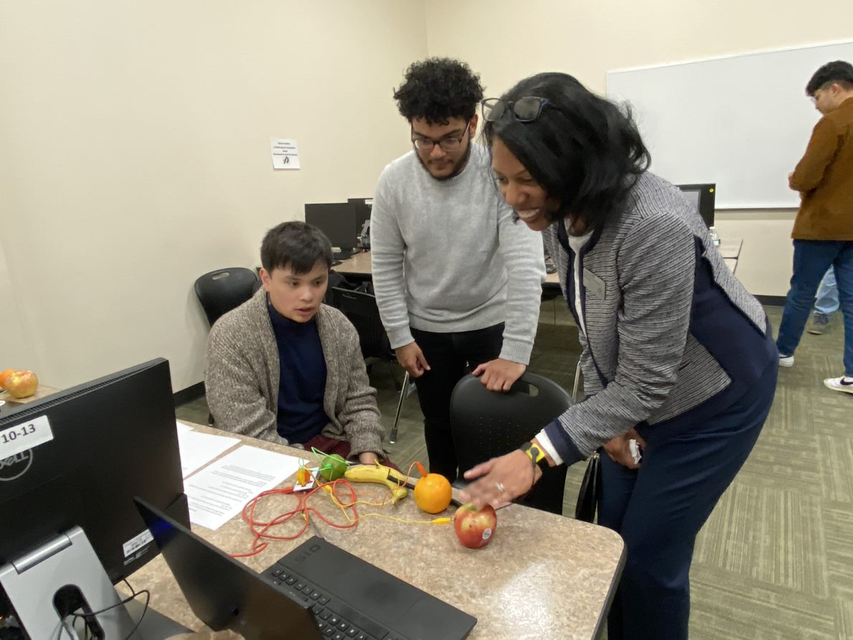
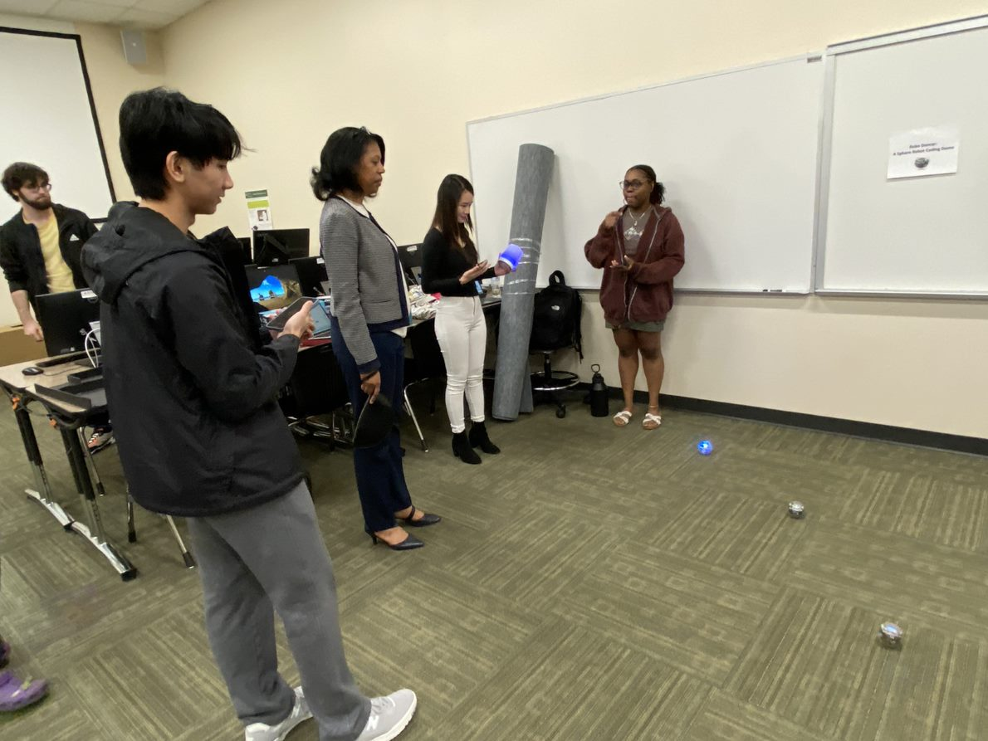
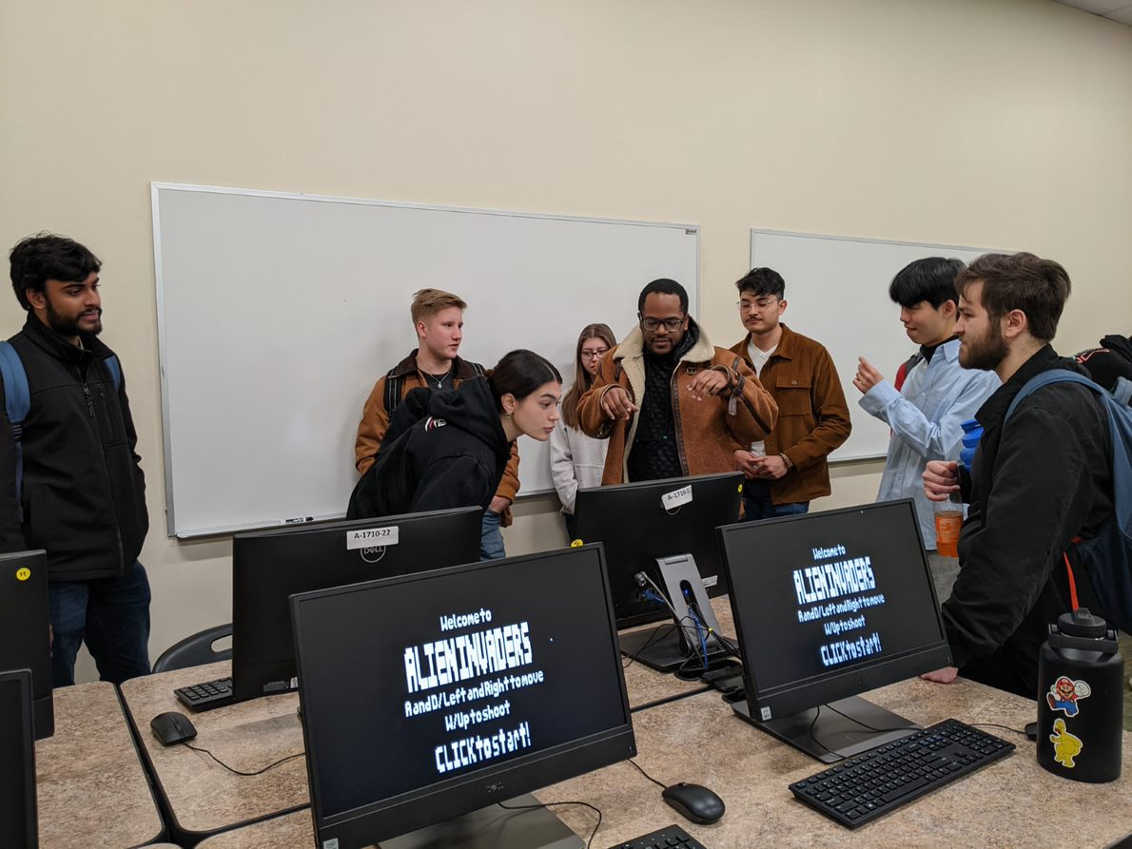
Other Teams Cont.

Slide 8

What is foes?
riendly, two player game
ppose your opponent
arn powerups to get stronger.
hoot the opponent to win the game
F
O
E
S

Slide 9
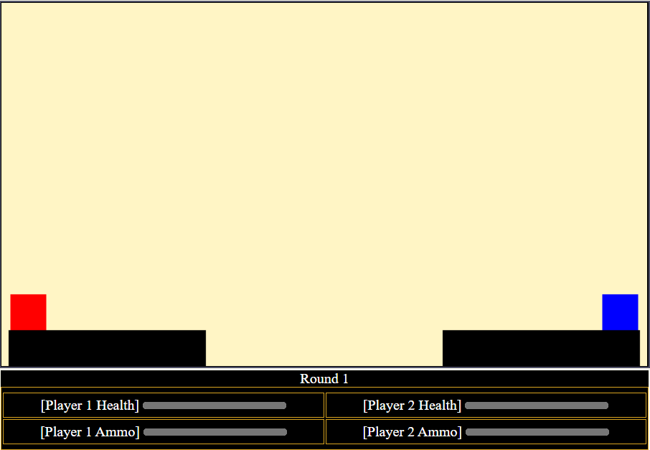
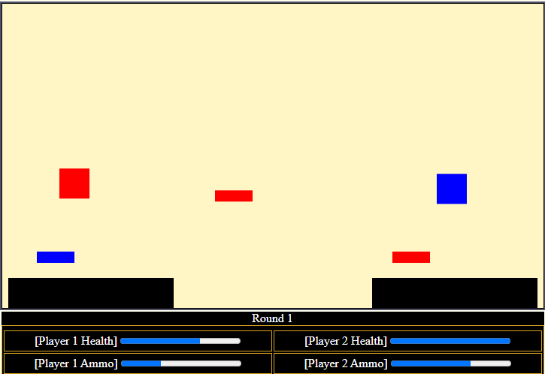
Please go to aburns10.altervista.org

Slide 10
How to play/rules
Each Player starts with:
3 health
A double jump
3 'shots'
Each player must shoot the other while dodging the enemy player's projectiles. Losing all of your health results in a Round Loss.
The first player to win 5 rounds wins the game.
However:
When a player loses a round, they are offered 1 of 2 powerups.
These powerups are randomized and stack.
PLAYER 1 CONTROLS | PLAYER 2 CONTROLS
W: Jump A / D: Left/Right V: Shoot | Arrow Key Up: Jump Left/Right Arrow Keys: Left/Right Forward Slash(/): Shoot

Slide 11
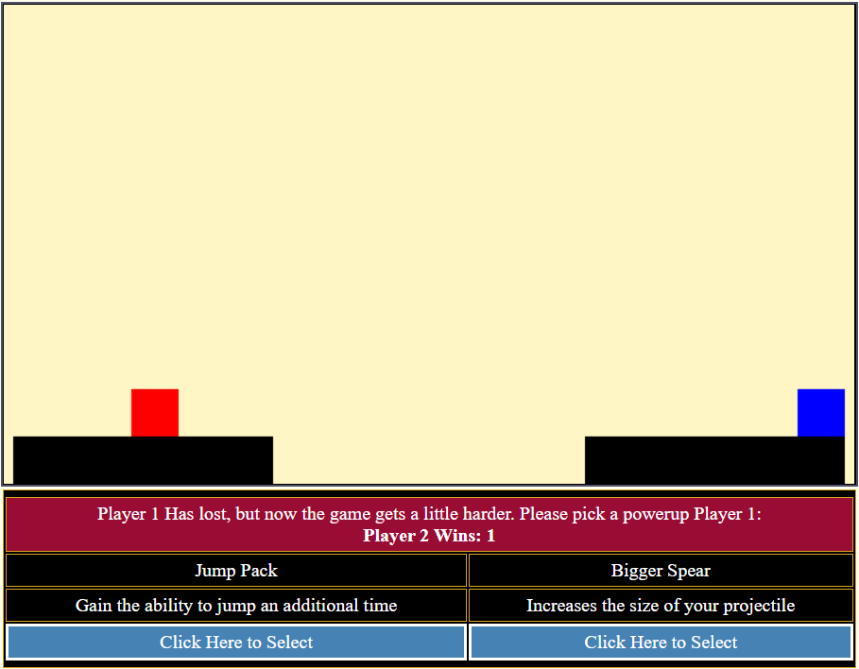
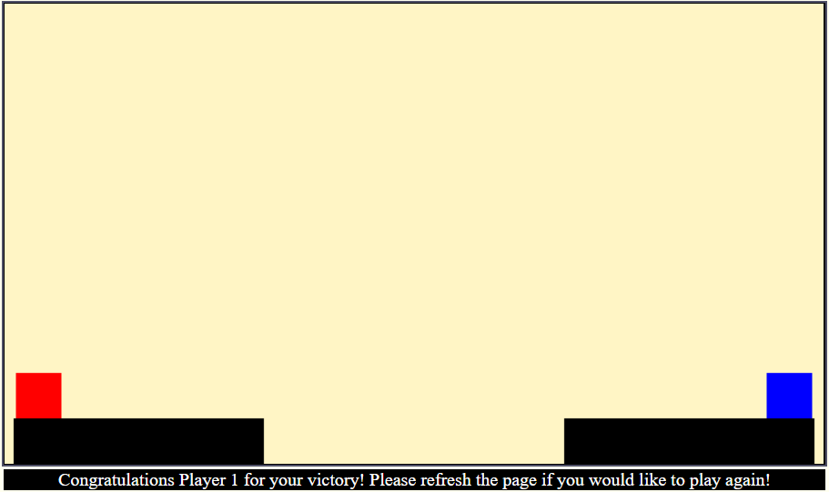
Player 1
Player 2
Results

Slide 12
Exercise 1
In this exercise, we will learn how Web Page Elements can be altered with JavaScript.
This exercise will teach you the basics about how web-pages are formatted, and the basics of how JavaScript works.

Slide 13
What is a webpage?
Web Pages are hypertext files hosted on the internet. Most, if not all Web Pages are formed using the following programming languages:
HyperText Markup Language Version 5 (HTML5)
Cascading Style Sheets (CSS)
*JavaScript (Not Related to Java)
*PHP (Hypertext Preprocessor)

Slide 14
What do they do?
In Layman's Terms: These programs do the following.
HTML – Creates boxes on the Web Page and then stores text inside of them. These boxes are called 'Tags'
<h1> Hello! </h1> Creates a header
CSS - Takes elements from HTML and changes how they look.
*JavaScript/PHP Perform Frontend (Client Side) or Backend (Server Side), processes – and can alter web elements in ways beyond the scope of HTML and CSS.
*Not required for a Web Page to function, but very useful.
Please Proceed to Exercise 1.

Slide 15
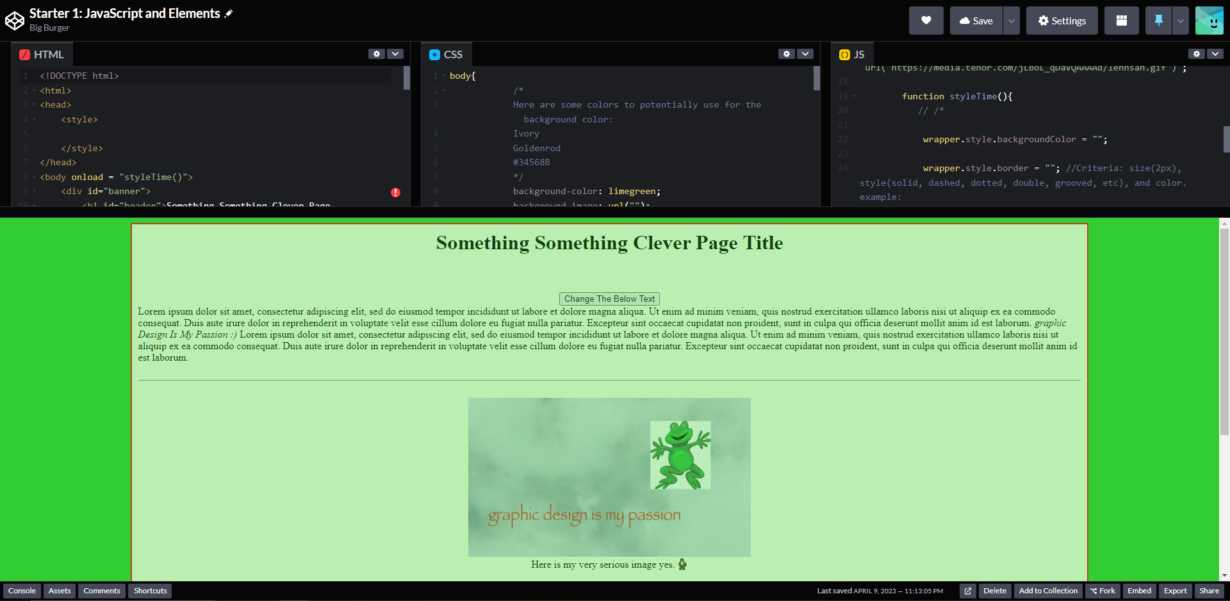
Please Proceed to Exercise 1 on Code-pen

Slide 16
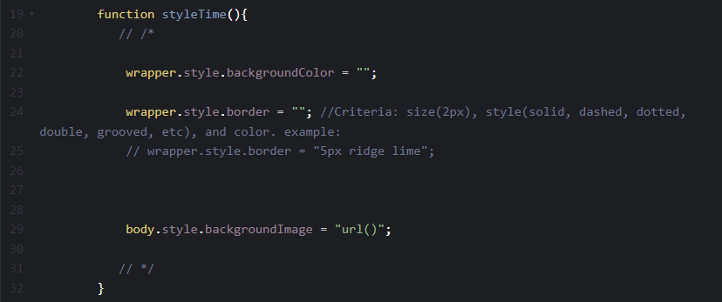
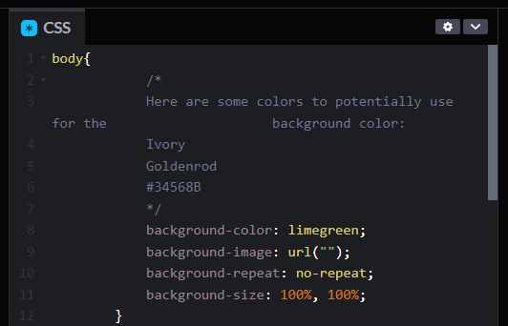
Step 1 – style the page with JS – Line 19 JS

Slide 17
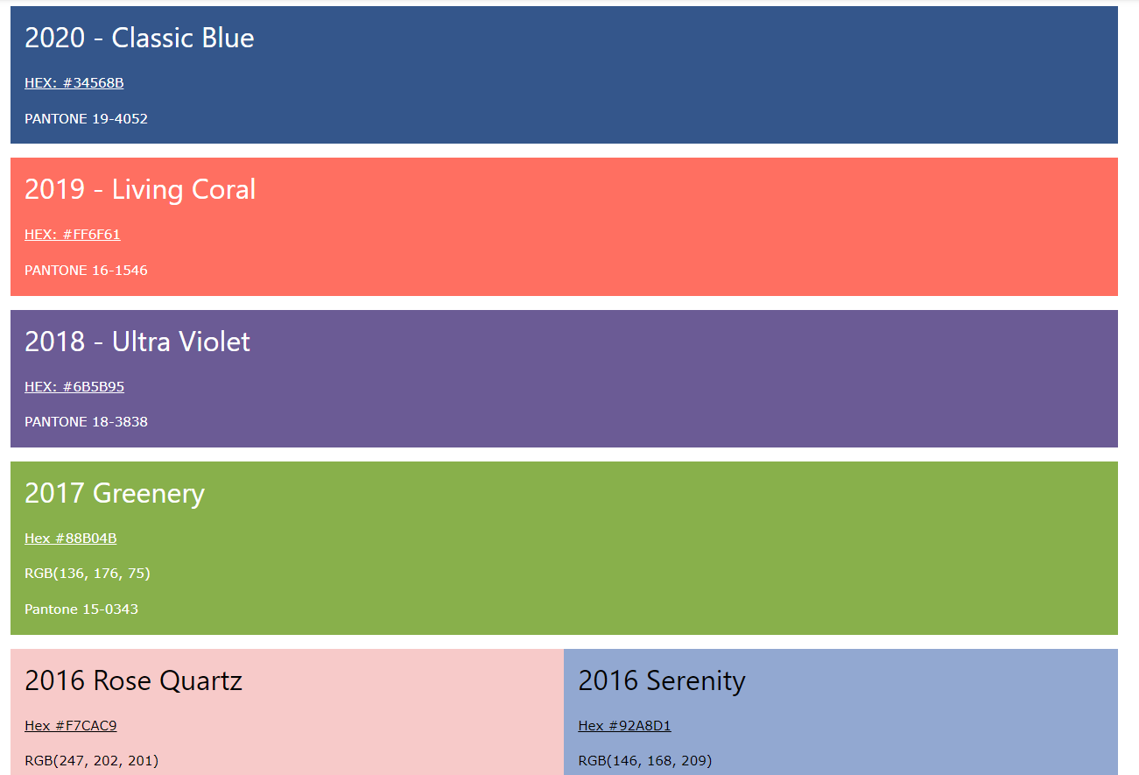
Change The Background Color

Slide 18
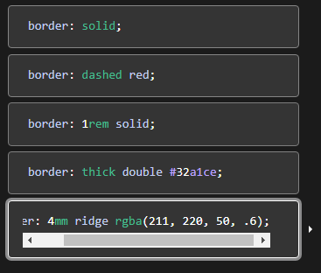
Style the Extremely ugly border

Slide 19
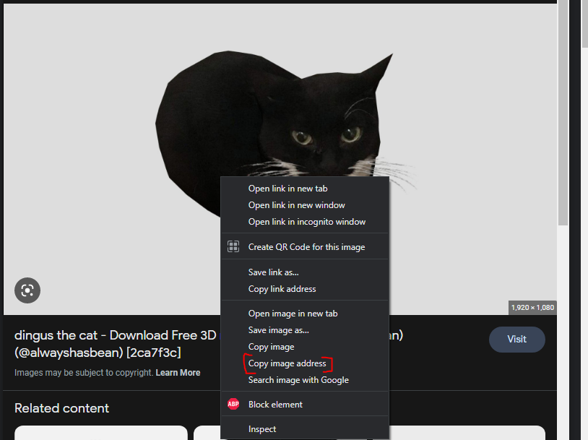
Change background image to something nice

Slide 20
Change background image to something nice

Slide 21
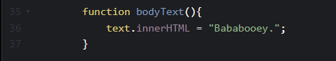
LAST STEP – CHANGE TEXT

Slide 22
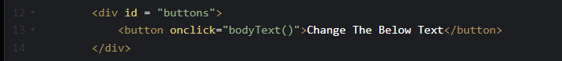
LAST STEP – CHANGE TEXT

Slide 23

Bask in the beauty of your web page

Slide 24
Exercise 2
In this exercise, we will learn how to animate objects in JavaScript using the canvas
In the first animation, we should only see a red box at the top left corner
We are going to edit our code to make it move to the right

Slide 25
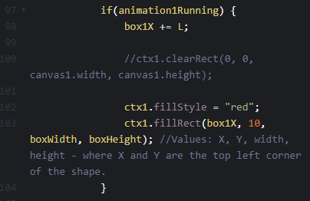
Exercise 2 step 1
We are going to change L to the amount of pixels we want the box to move to the right per interval

Slide 26
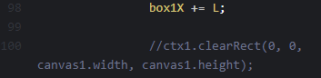
Exercise 2 step 1
You will notice that the canvas still has a red box drawn on areas where our box was previously
This is because we haven't cleared out the canvas before drawing our box in a new position
We will now uncomment line 100 to clear our canvas before a new box is drawn

Slide 27
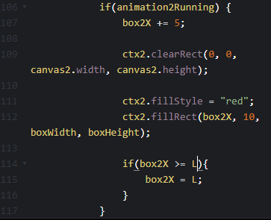
Exercise 2 step 2
In animation 2, we should have the same result as animation 1
This time, we want to prevent the box from moving off of the screen, so we are going to use if statements
We want to change L to canvas2.width

Slide 28
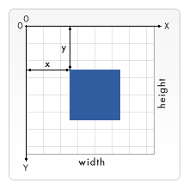
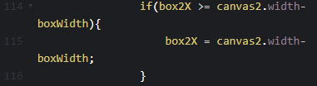
Exercise 2 step 2
Despite adding the if statement, our box has still traveled outside of the canvas
This is because when we draw the box at an X coordinate, JavaScript will draw the box to the right of the coordinate
With this in mind, we need to set the value of X to the end of the canvas minus the box's width

Slide 29
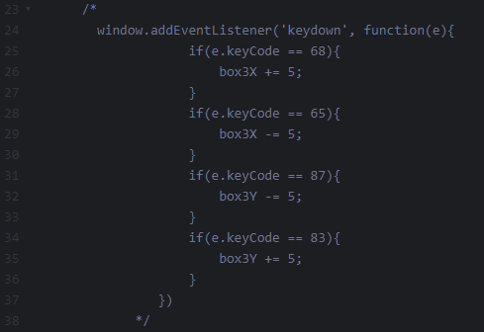


Exercise 2 step 3
In animation 3, we will make our box move once it receives an input from the user
After we uncomment this section of our code by getting rid of /* and */, you should be able to move the box with a and d

Slide 30
Exercise 2 step 3
How does this code allow user input?
First, we place an event listener to trigger whenever a key on the keyboard is pressed
Next, we add an if statement so moving the box can only be done if the key held down is A or D
Each key on the keyboard has a number id attached to them
For example, A is 65 and D is 68
If you want to find out every number id for each key, go to this site: http://gcctech.org/csc/javascript/javascript_keycodes.htm

Slide 31


Q/A?

Slide 32

Thank You
Credits:
Alec Burns (coding developer, web designer)
Alex Shaklee (coding developer, web designer)
Sheondra baker (marketing designer, tech designer)

